Slide 1

Credit Card Spending
Analysis
750
₹67.79L
12
Transactions
Total Spend
Months
Synthetic credit card transactions | Generated for analysis practice

Slide 2
Executive Summary
02
A high-level overview of transaction volume, spend, risk and rewards
750
₹67.79L
₹9,038
₹1.07L
Total Transactions
Total Spend
Average Transaction
Total Cashback
120
64 (8.5%)
35 (4.7%)
20 (2.7%)
Unique Customers
High-Risk Txns
Overdue Txns
International Txns
KEY TAKEAWAY
• Shopping dominates the portfolio with 63.8% of total spend.
• Online is the strongest channel with 52.5% spend share.
• High-risk transactions are only 8.5% by count but form 30.1% of spend.
Credit Card Spending Analysis

Slide 3
Motive of the Data
03
Why this credit card spending dataset is analyzed
WHAT THE DATA COVERS
BUSINESS MOTIVE
ANALYSIS METHOD
• 750 synthetic credit card transactions
• 120 unique customer IDs
• 20 fields: card type, category, city, channel, amount, rewards, risk and status
• Analysis period: Jul-2025 to Jun-2026
• Understand where customers spend most money
• Identify top card/customer segments
• Monitor risk, overdue and international usage
• Improve cashback, rewards and campaign planning
• Aggregate spend by category, month, city and card type
• Compare transaction count vs value
• Evaluate payment channel adoption
• Highlight risk and payment behavior
Credit Card Spending Analysis

Slide 4
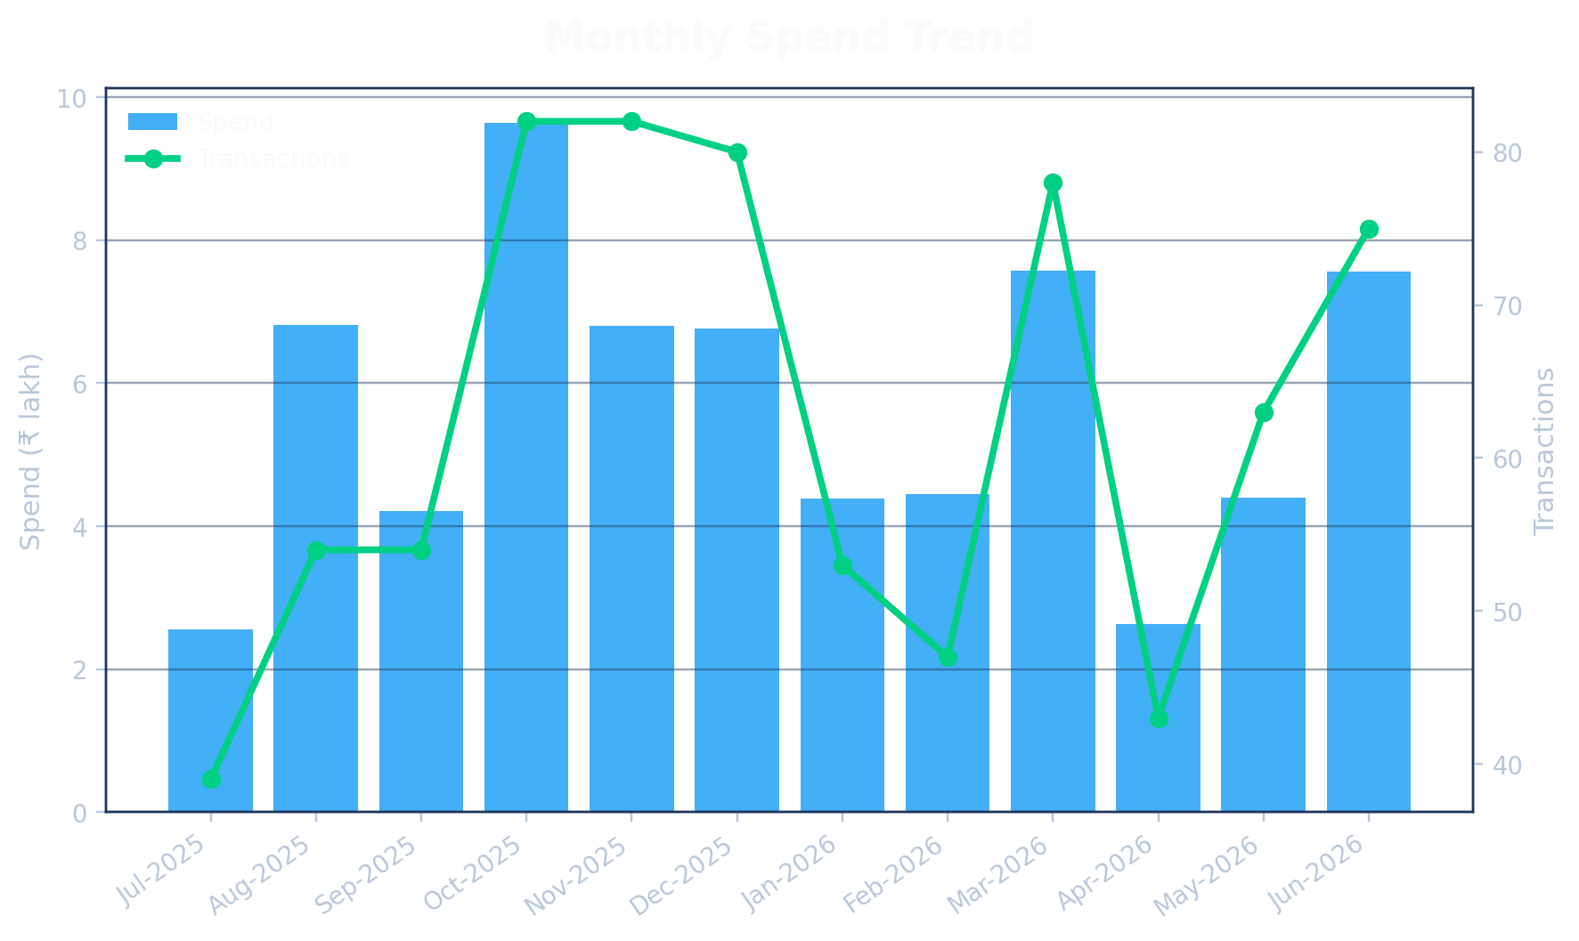
Monthly Spending Trend
04
Spending movement over the 12-month period
TREND FINDINGS
• Peak month: Oct-2025 with ₹9.64L spend.
• October and November record the highest transaction volume: 82 transactions each.
• Spend grows again in Mar-2026 and Jun-2026, showing seasonal or campaign-driven spikes.
Top 3 Spend Months
Month | Spend | Txns
Oct-2025 | ₹9.64L | 82
Mar-2026 | ₹7.58L | 78
Jun-2026 | ₹7.56L | 75
Credit Card Spending Analysis

Slide 5
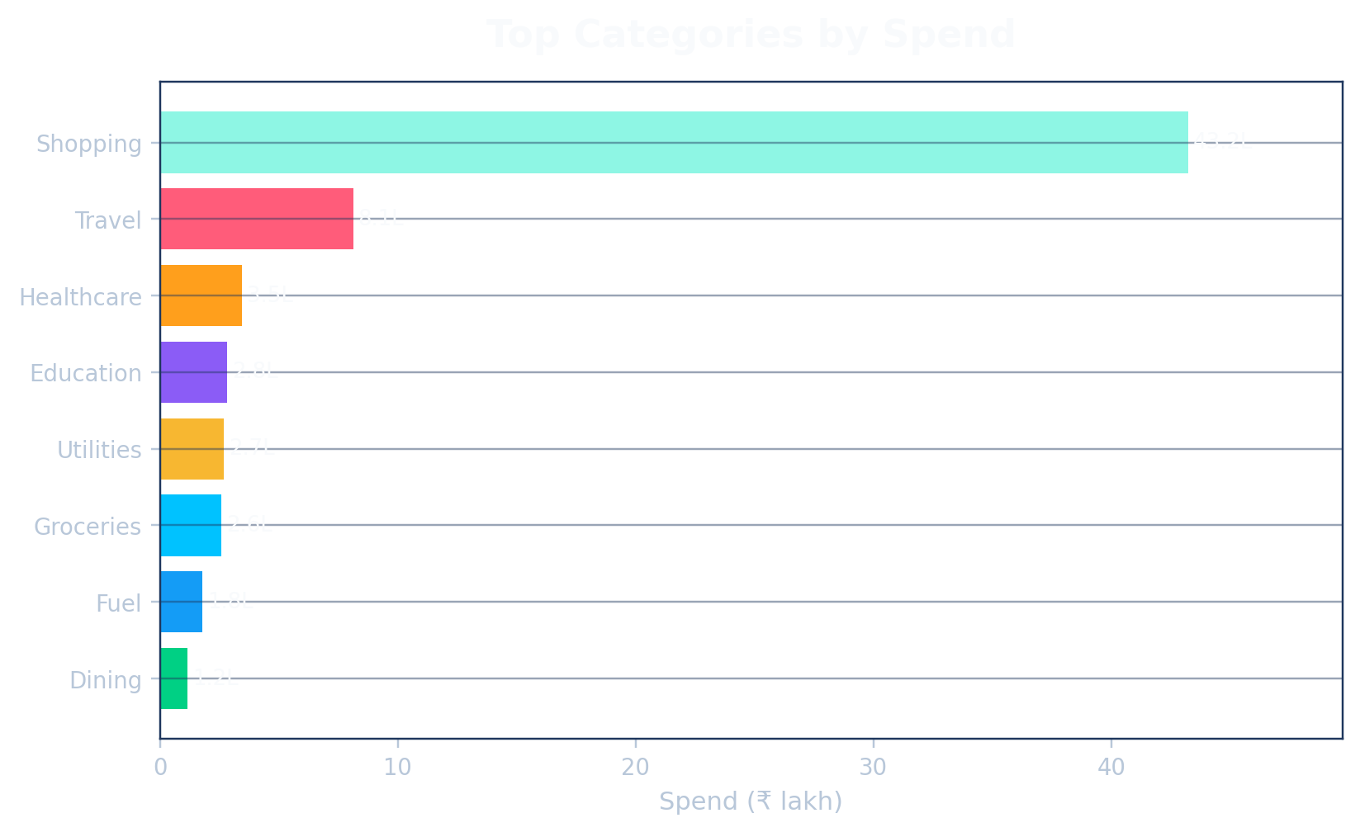
Category Spending Analysis
05
Which spend categories drive the portfolio
CATEGORY FINDINGS
• Shopping is the largest category: ₹43.24L (63.8% of total spend).
• Travel is the second-largest category with ₹8.13L.
• Shopping also contributes most of the high-risk transactions.
Top Categories
Category | Spend | Avg Txn
Shopping | ₹43.24L | ₹26,527
Travel | ₹8.13L | ₹11,286
Healthcare | ₹3.46L | ₹6,066
Education | ₹2.83L | ₹10,110
Credit Card Spending Analysis

Slide 6
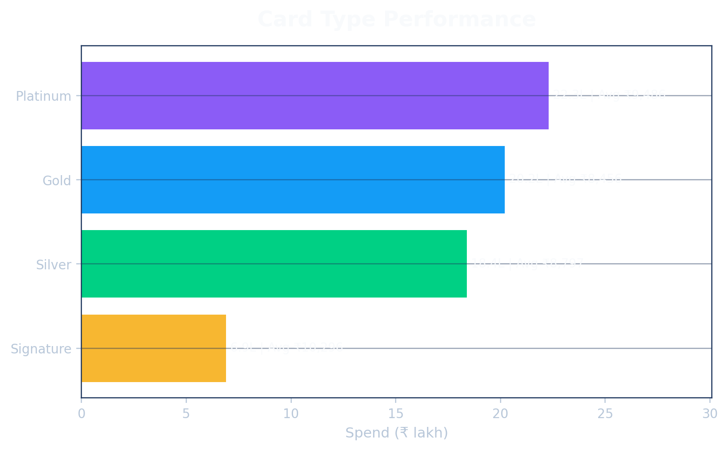
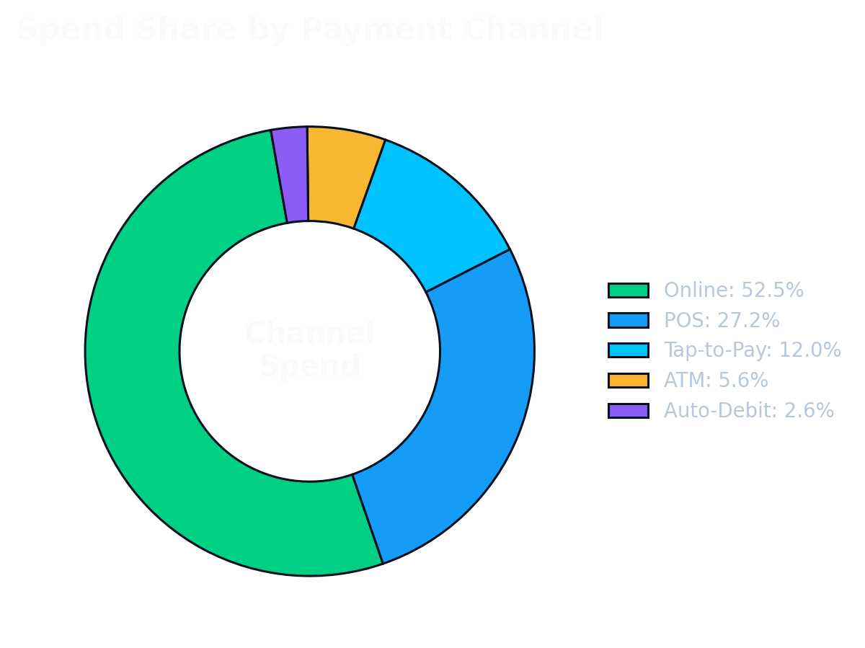
Card Type & Payment Channel Performance
06
How spending changes by card tier and channel
PERFORMANCE FINDINGS
• Platinum contributes the highest spend: ₹22.29L (32.9%).
• Signature has the highest average transaction value: ₹10,296.
• Online channel leads with 52.5% spend and 43.3% transactions.
Credit Card Spending Analysis

Slide 7
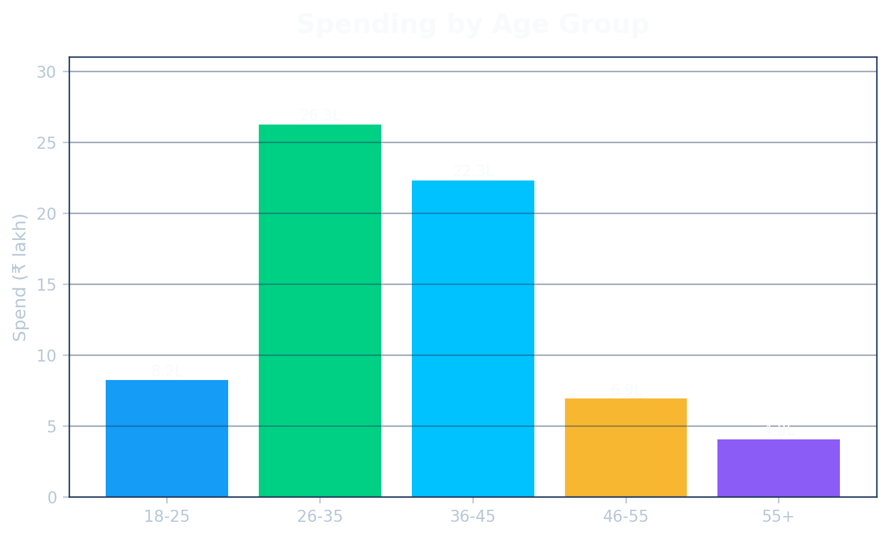
Customer Demographics
07
Spend contribution by age group and gender
GENDER SPLIT
Male
₹38.63L (57.0%)
Female
₹25.93L (38.3%)
Other
₹3.23L (4.8%)
DEMOGRAPHIC FINDINGS
• 26-35 age group has the highest spend: ₹26.28L (38.8%).
• 36-45 is the second strongest segment with ₹22.32L.
• Male customers contribute ₹38.63L; female customers contribute ₹25.93L.
Credit Card Spending Analysis

Slide 8
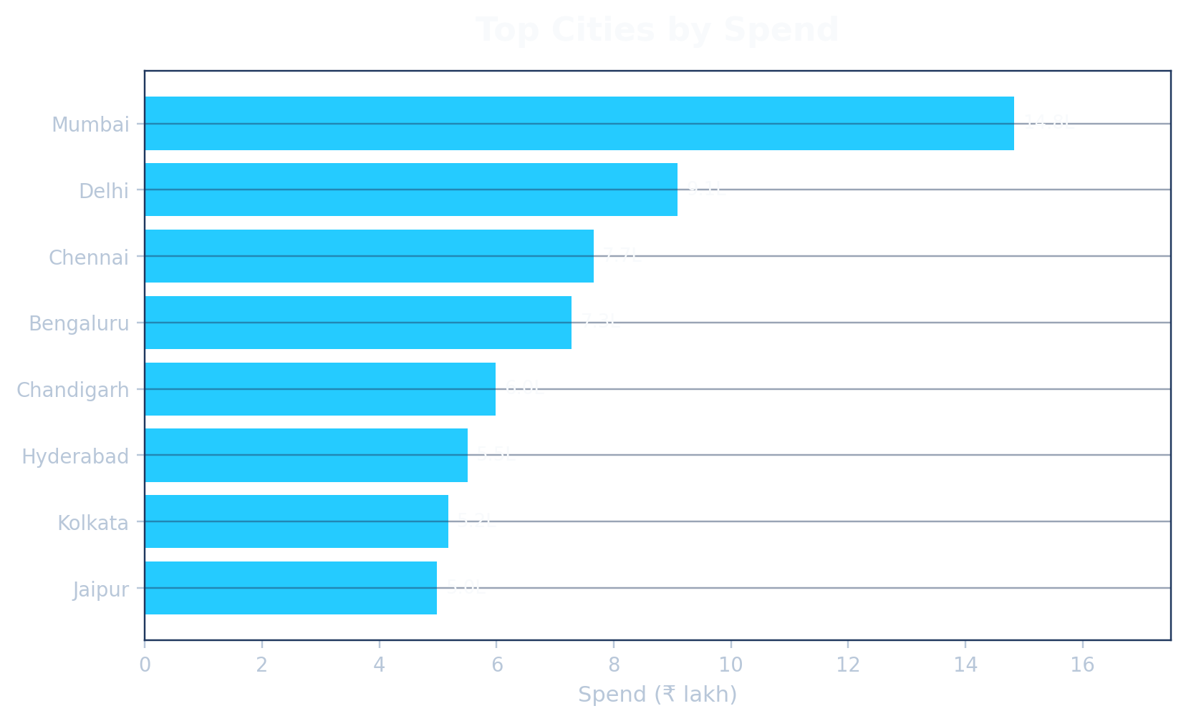
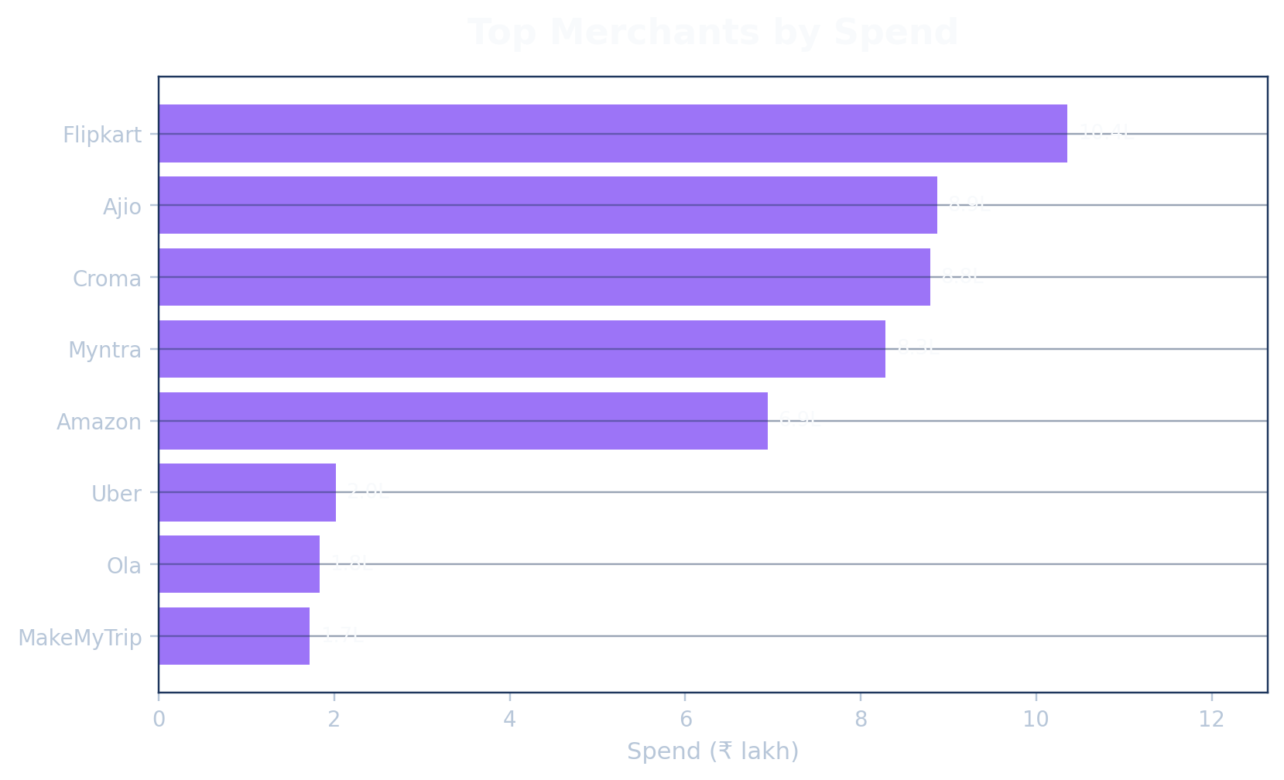
City & Merchant Insights
08
Where spend is concentrated geographically and commercially
• Mumbai is the top city with ₹14.83L (21.9% share).
• Chandigarh has a high average transaction value: ₹10,147.
• Top merchants help identify campaign partners and high-value customer touchpoints.
LOCATION FINDINGS
Credit Card Spending Analysis

Slide 9
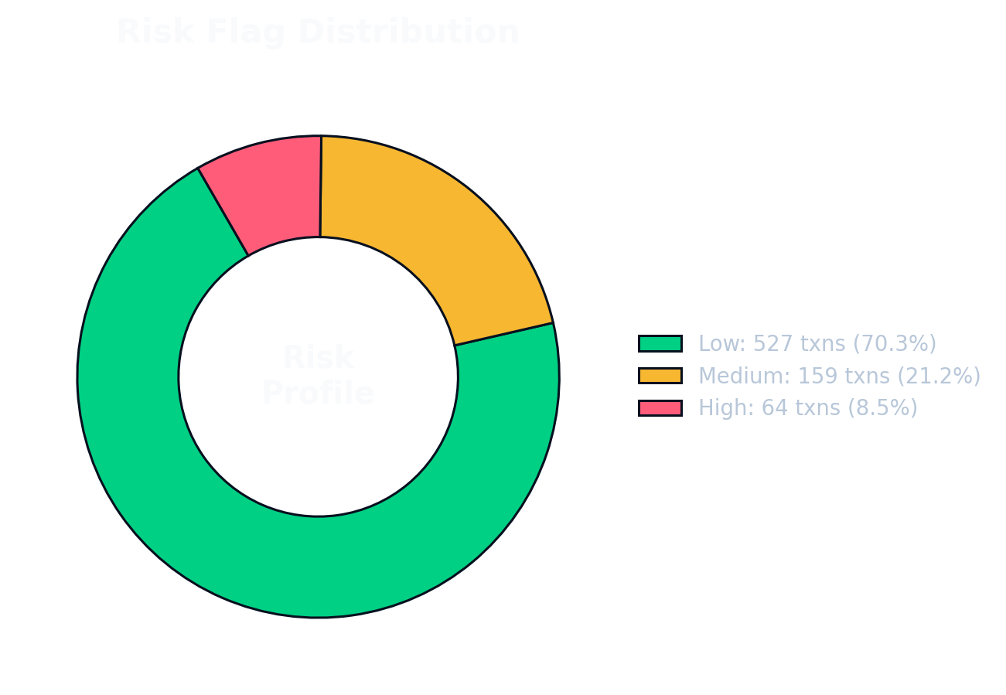
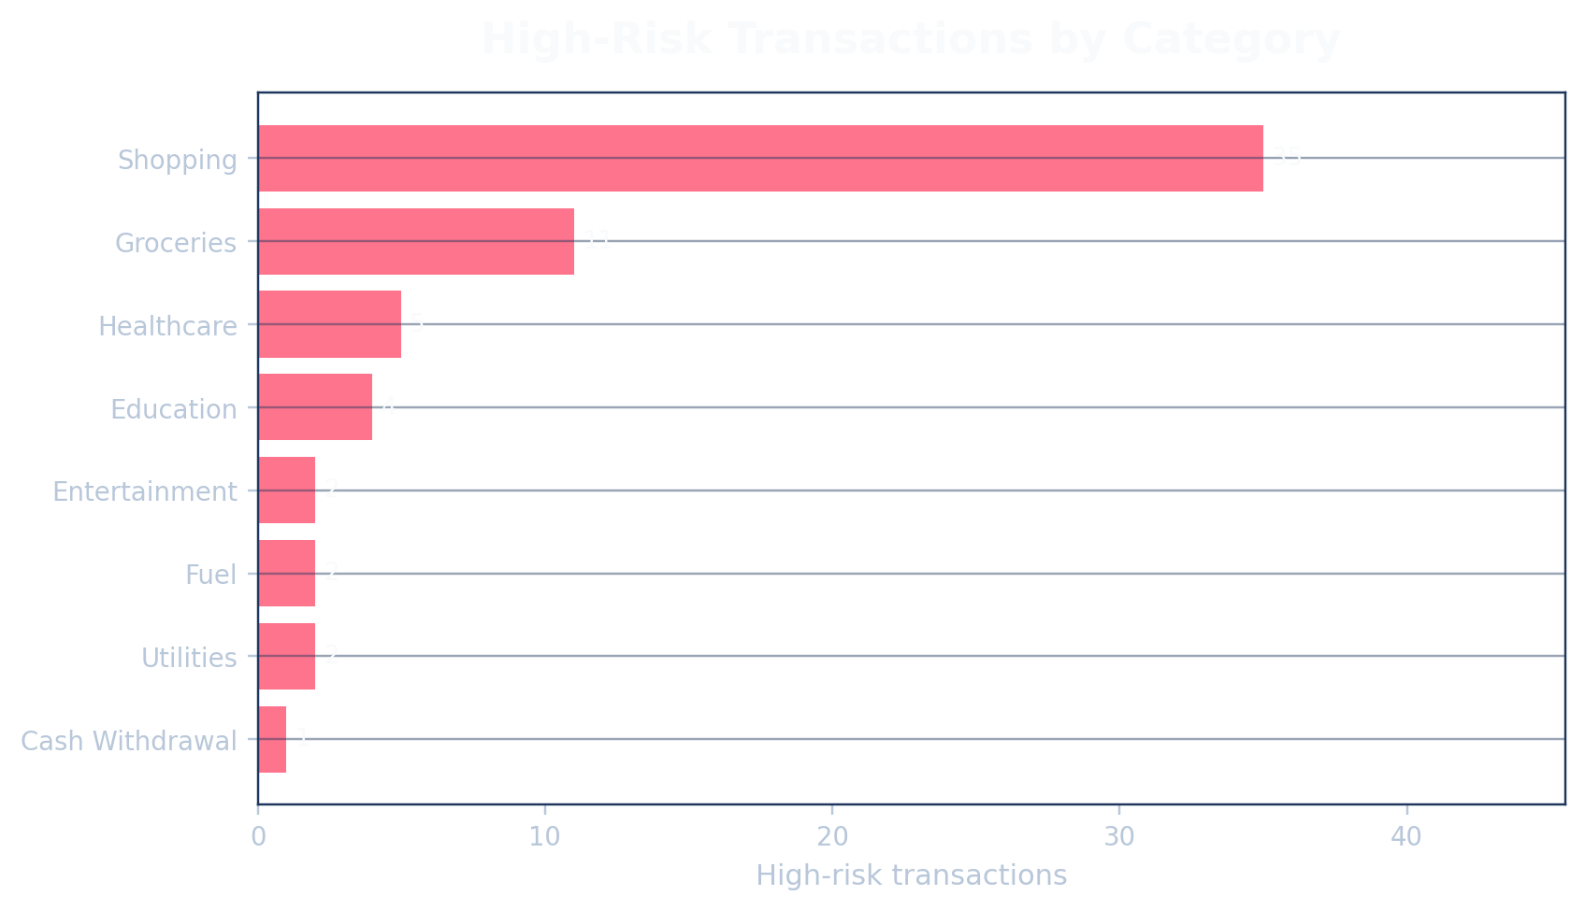
Risk & Payment Behavior
09
Monitoring risk flags and payment status
• High-risk transactions: 64 (8.5%) but spend value is ₹20.39L.
• High-risk spend forms 30.1% of total spend, so value exposure is much higher than count exposure.
• Overdue transactions: 35 (4.7%); paid transactions are 616 (82.1%).
RISK FINDINGS
Credit Card Spending Analysis

Slide 10
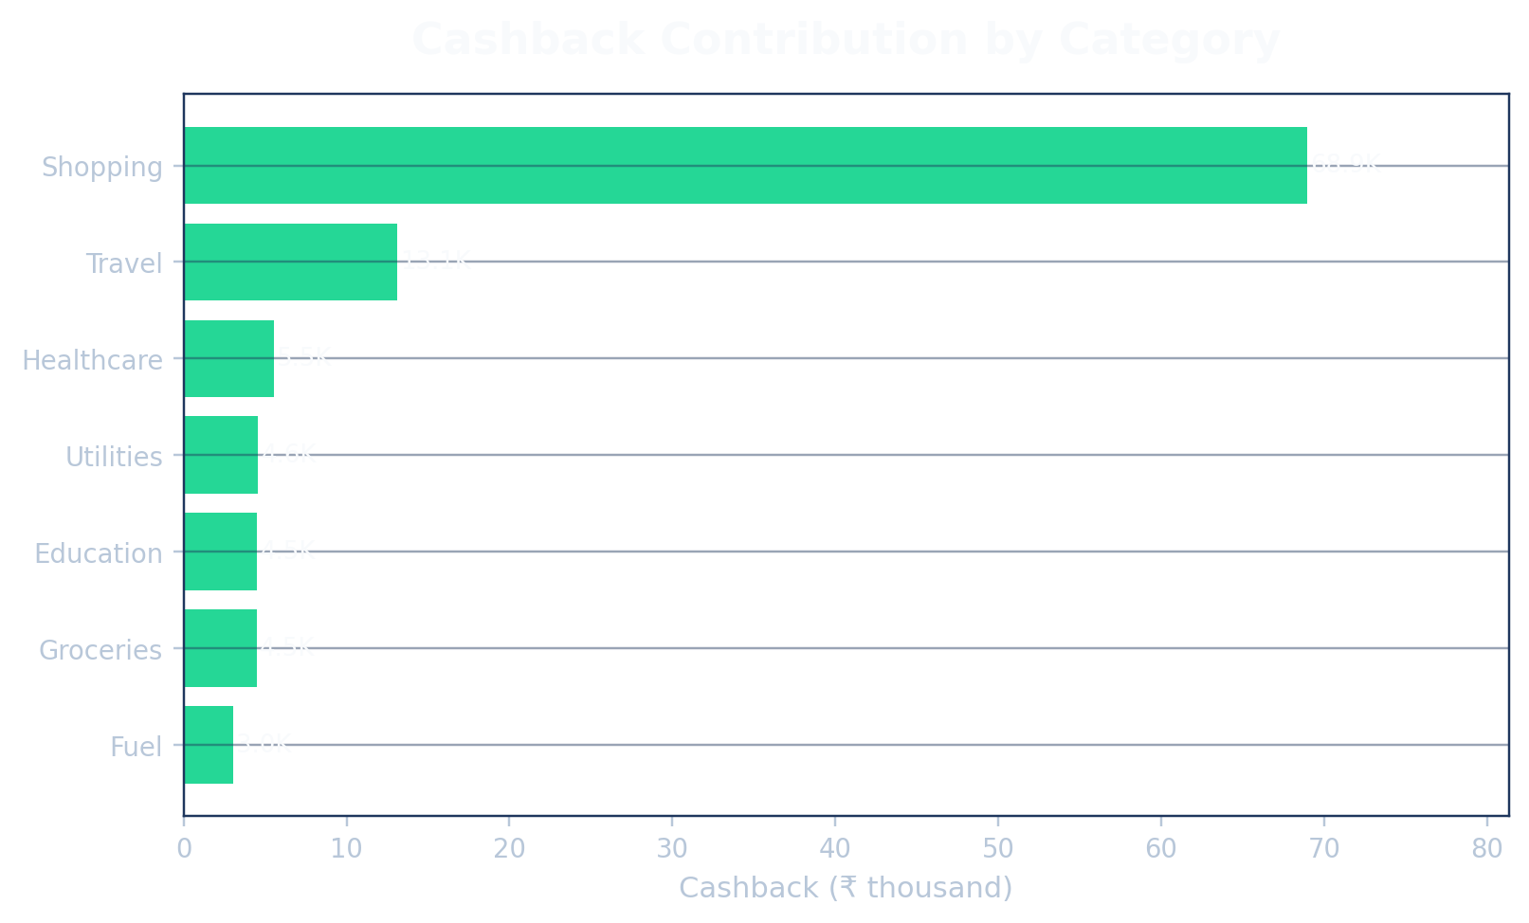
Cashback & Rewards Analysis
10
Reward cost and category contribution
REWARD VIEW
₹1.07L
1.58%
Total Cashback
Cashback Rate
96,505
Shopping
Reward Points
Top Cashback
• Shopping generates 64.2% of total cashback.
• Cashback spend should be watched because a high concentration may reduce profitability.
• Reward optimization can target high-value categories while keeping risk control.
Credit Card Spending Analysis

Slide 11
Overall Findings from the Data
11
What the dataset reveals after analysis
SPEND DRIVER
PEAK PERIOD
CHANNEL BEHAVIOR
Shopping is the main spend driver with ₹43.24L, almost 63.8% of total spend.
Oct-2025 is the highest spend month at ₹9.64L; Oct-Nov show strongest activity.
Online has the largest share: ₹35.60L spend and 325 transactions.
CUSTOMER SEGMENT
RISK EXPOSURE
PORTFOLIO HEALTH
26-35 and 36-45 age groups together drive 71.7% of spend.
High-risk transactions are only 8.5% by count, but 30.1% by spend.
Paid transactions form 82.1% of total volume; overdue cases need focused follow-up.
Credit Card Spending Analysis

Slide 12
Conclusion, Motive & Overall Summary
12
Final interpretation of the credit card spending analysis
MOTIVE
OVERALL VIEW
• Analyze customer spending behavior
• Find high-value categories, cities and card types
• Understand risk and payment health
• Support dashboard/reporting decisions
• 750 transactions and ₹67.79L total spend
• Average transaction: ₹9,038
• Top segment: 26-35 age group
• Top channel: Online
CONCLUSIONS
RECOMMENDED ACTIONS
• Spending is highly concentrated in Shopping
• Online payments are the strongest customer behavior
• High-risk transactions are low in count but high in value
• Reward/cashback strategy needs careful monitoring
• Create targeted offers for Shopping and Travel
• Promote online/card-tier campaigns for Platinum and Gold users
• Track high-risk shopping transactions more closely
• Reduce overdue transactions with reminders and follow-up
This presentation converts the dataset into actionable business insights for credit card portfolio monitoring, campaign planning, and risk control.
Credit Card Spending Analysis

